Slide 1
Project Presentation
-Group 16
Skye Yang, Haohang Yang, Yunming Chen
Yichong Tian, Weidong Liu, Jiaxin Li

Slide 2
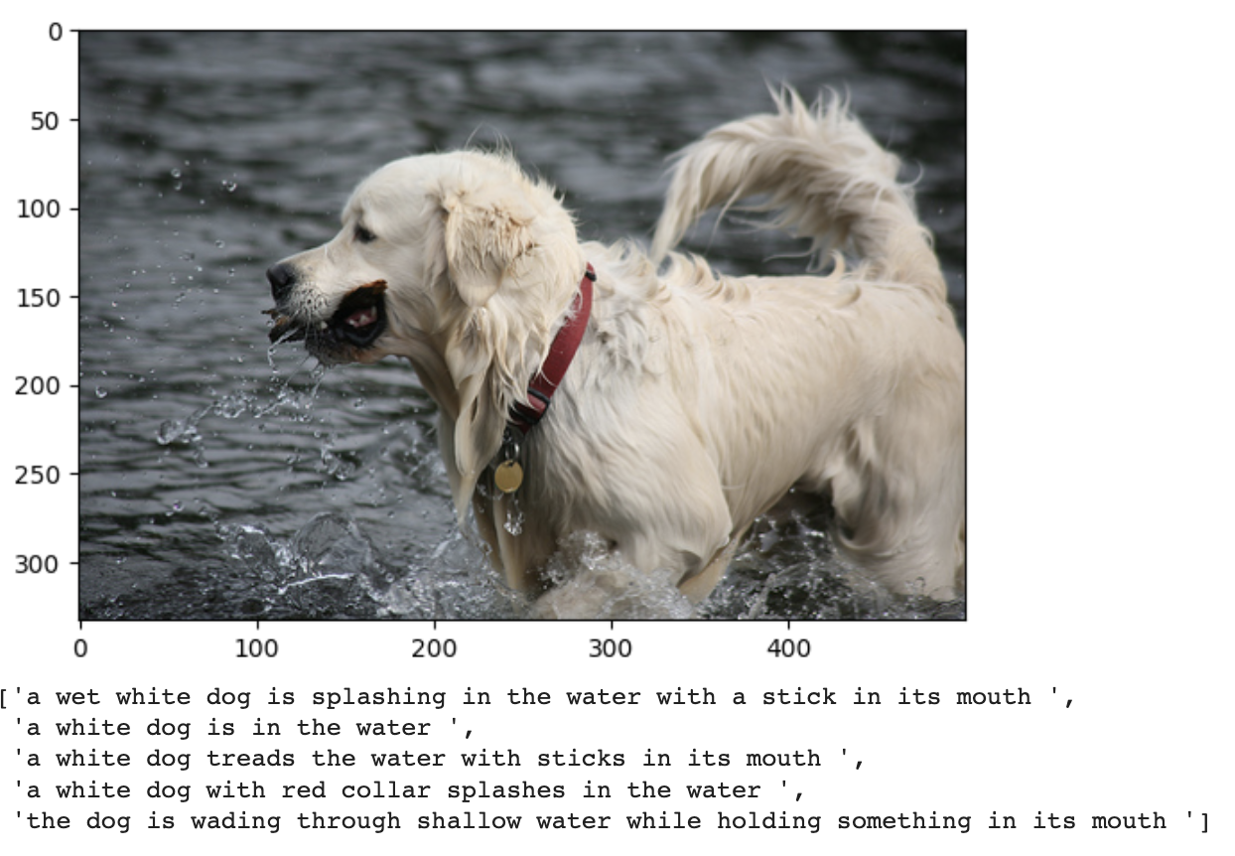
Introduction (topic & function)
Image Caption Generator
automatically generates a textual description or caption of an image
deep learning & natural language processing

Slide 3
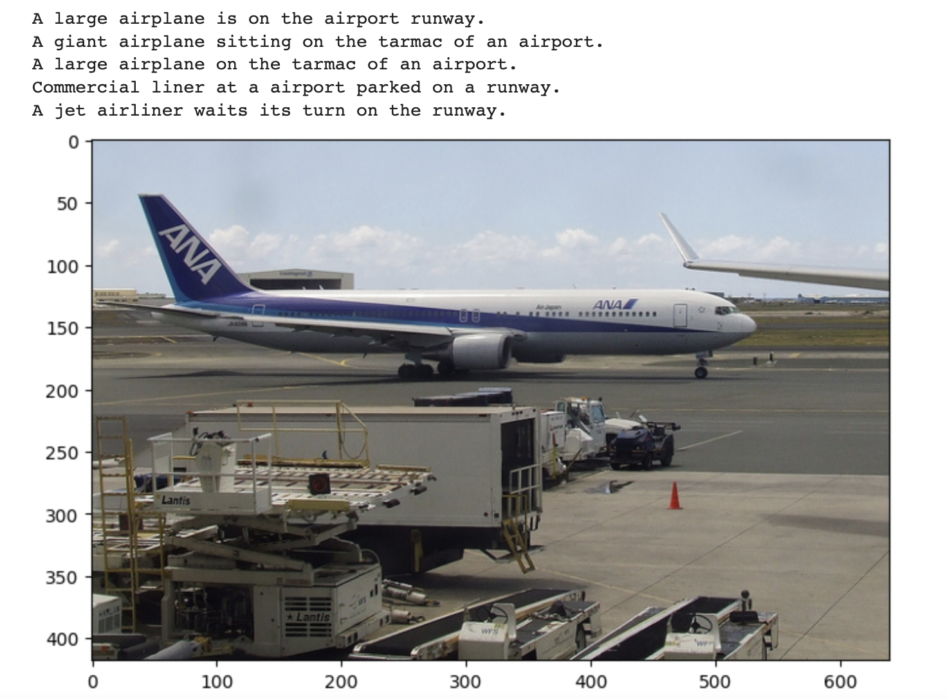
Model Training Workflow
Integer-to-word dict
Image features dict
Words dict
Sequence length
Etc
Data Preprocessing:
Glove embedding for description
Xception embedding for image
Raw data
Final Result
Data Generator
Take prediction result(word probabilities) from a image and then use greedy_search or beam_search_prediction to generate the description of the image
X1(Features Vector - Image | X2 (Text sequence) | Y (Output Sequence)
Image Features(2048) | A | Large
Image Features(2048) | A, Large | Airplane
Image Features(2048) | A, Large, Airplane | is
Image Features(2048) | A, Large, Airplane, is | on
A model that can predict the probability of a word from the text description sequence based on image feature
Feed the data in RNN-LSTM model

Slide 4
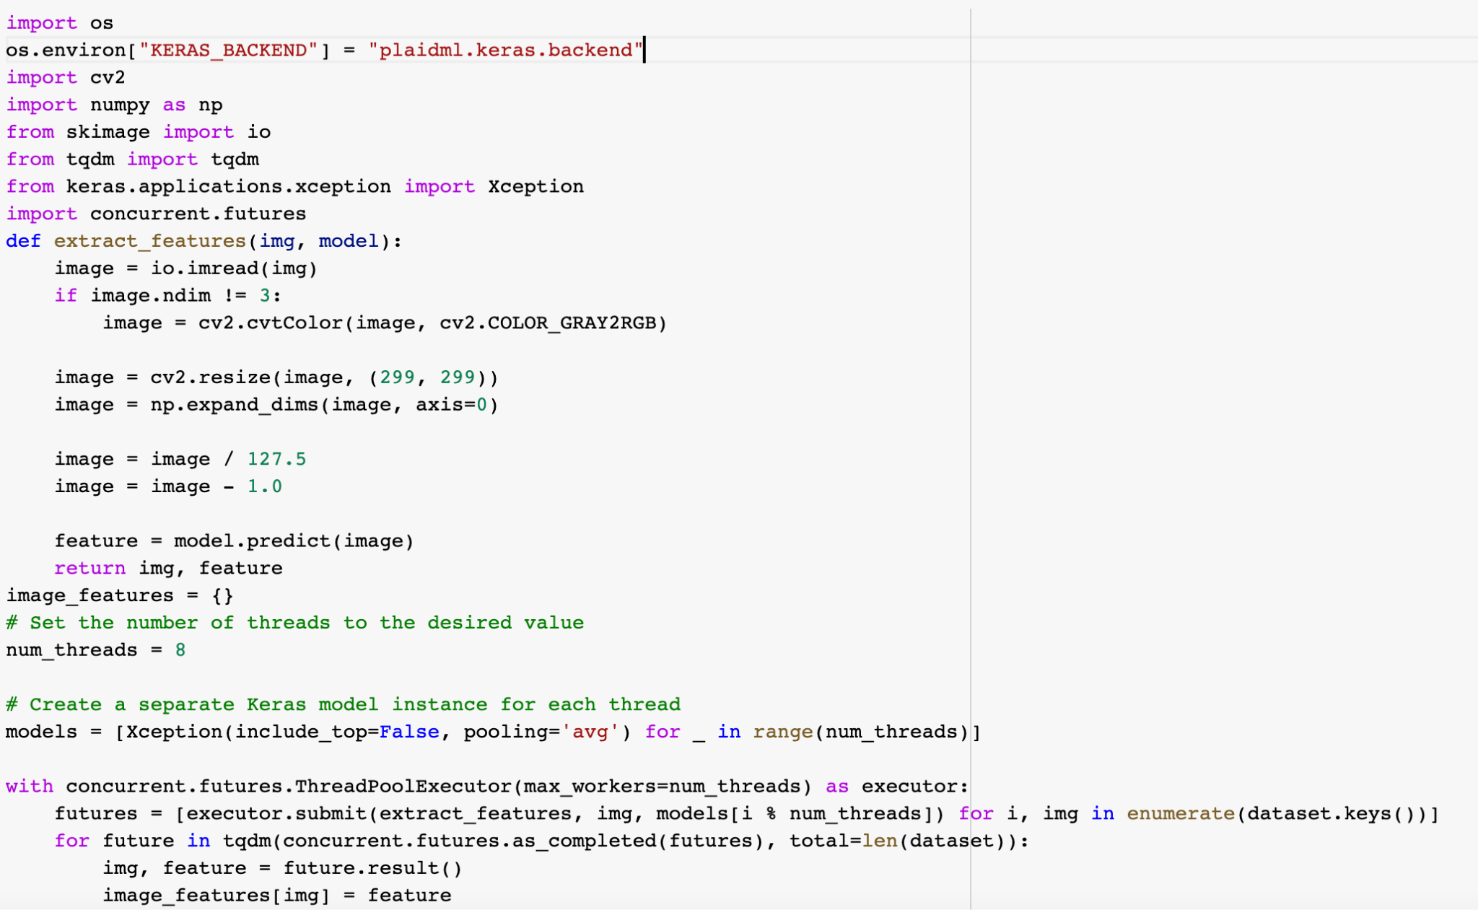
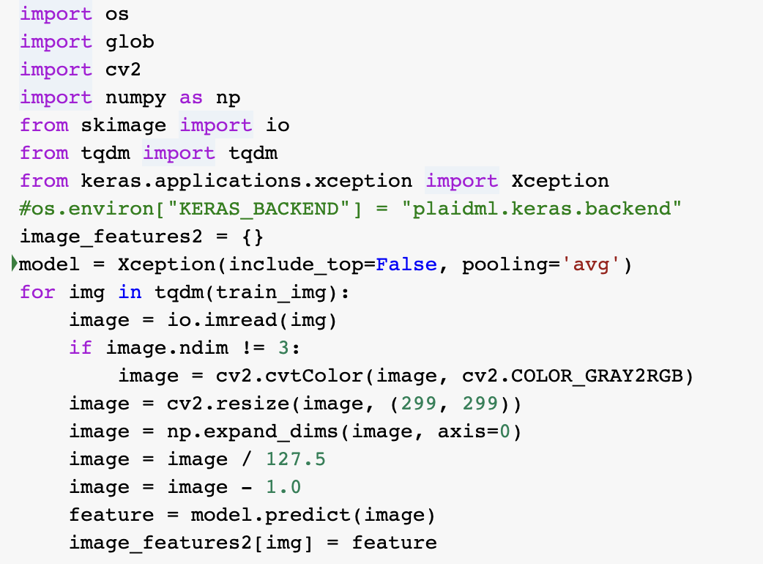
Optimization for Image Pre-Processing
Images pre-processing (Multi-Thread and GPU)
50min —> 14min
Multi-Thread

Slide 5
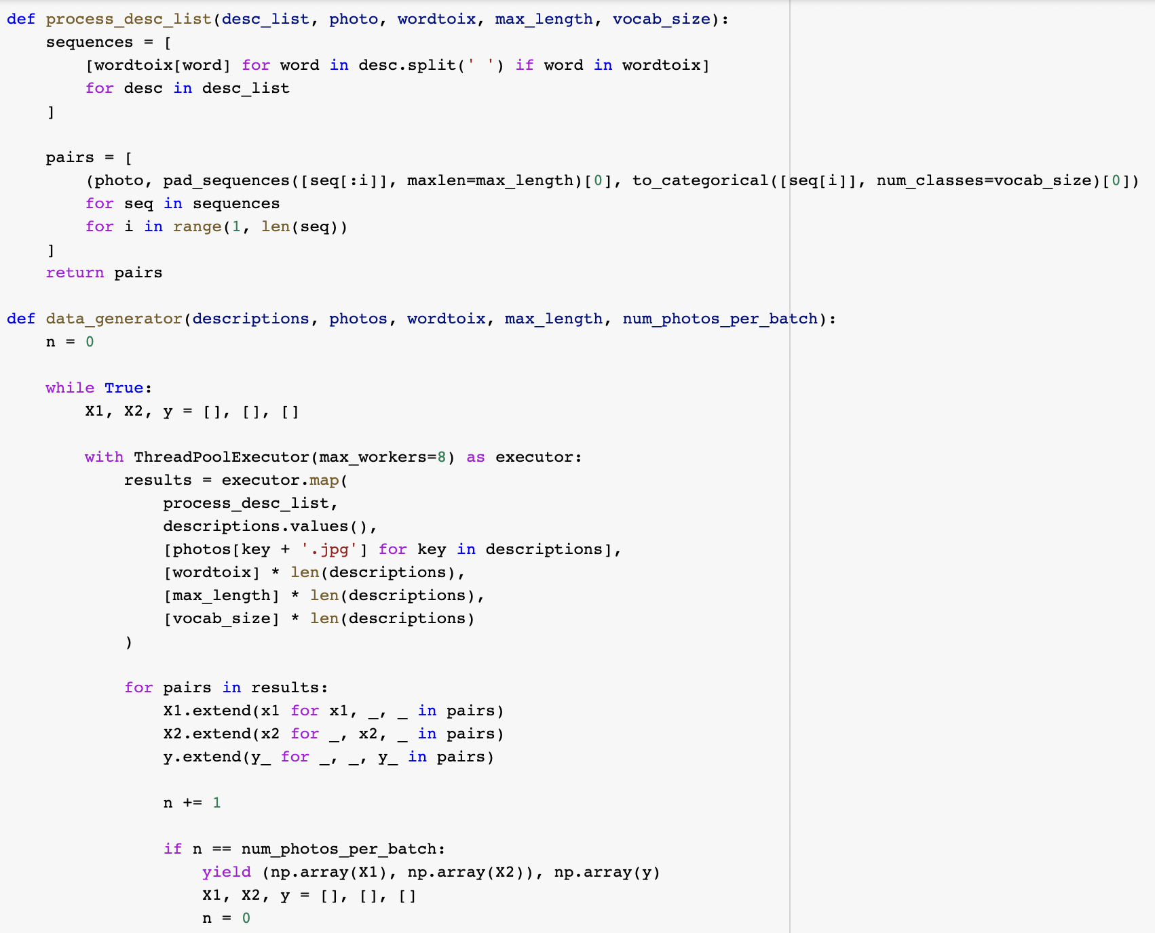
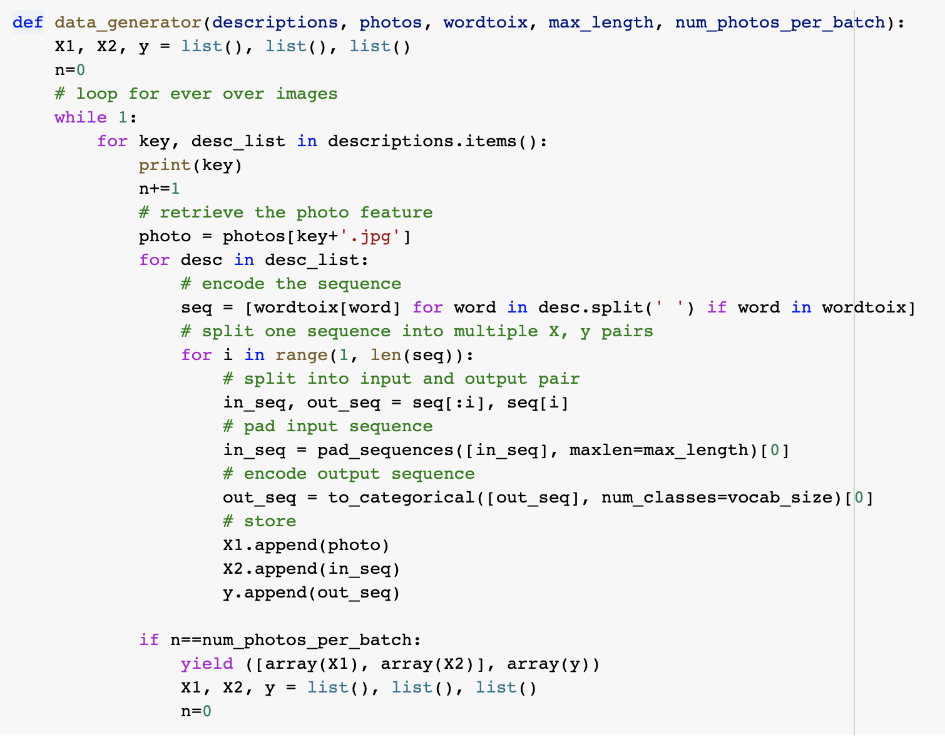
Optimization for data-generation
Data generator and model fitting (Multi-Thread and vectorization)
300s —> 270s per epoch
Multi-Thread

Slide 6
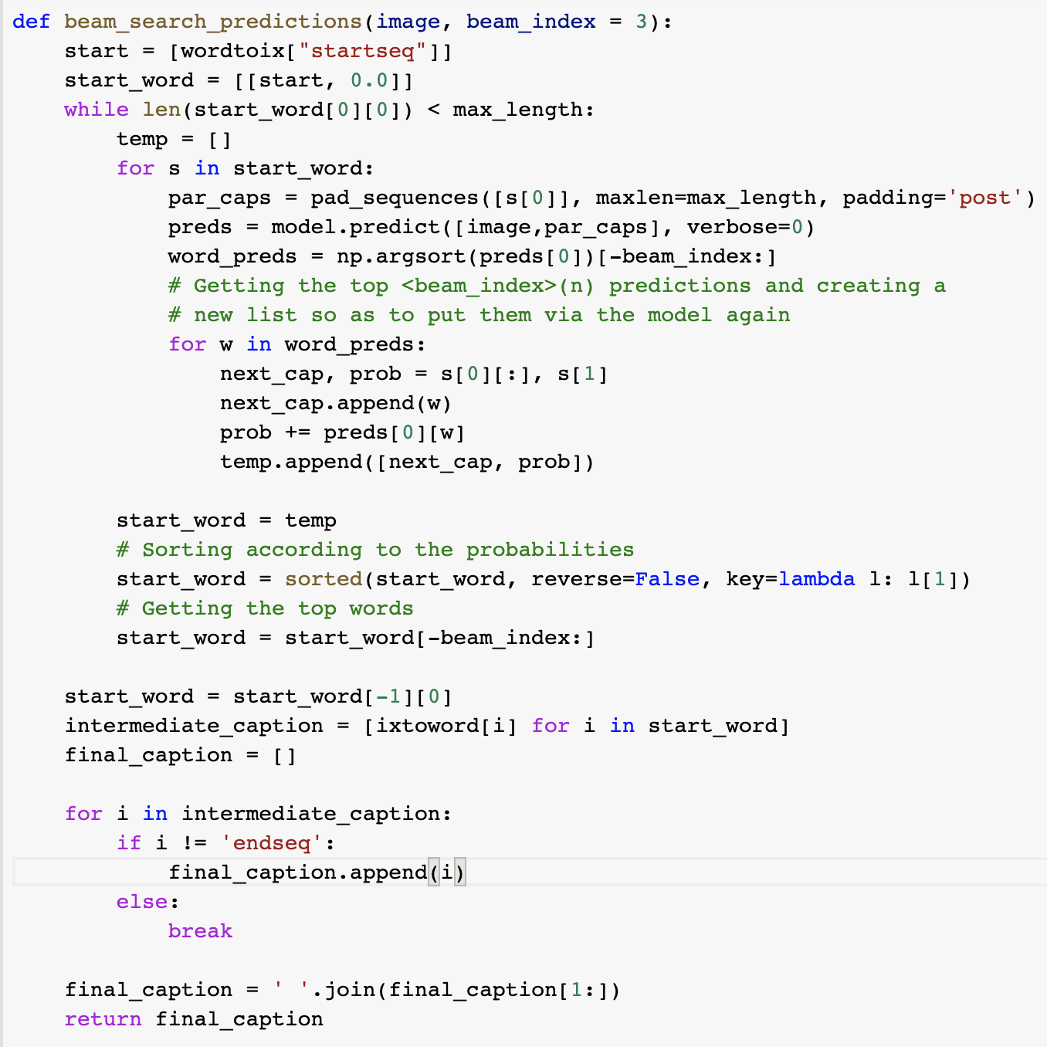
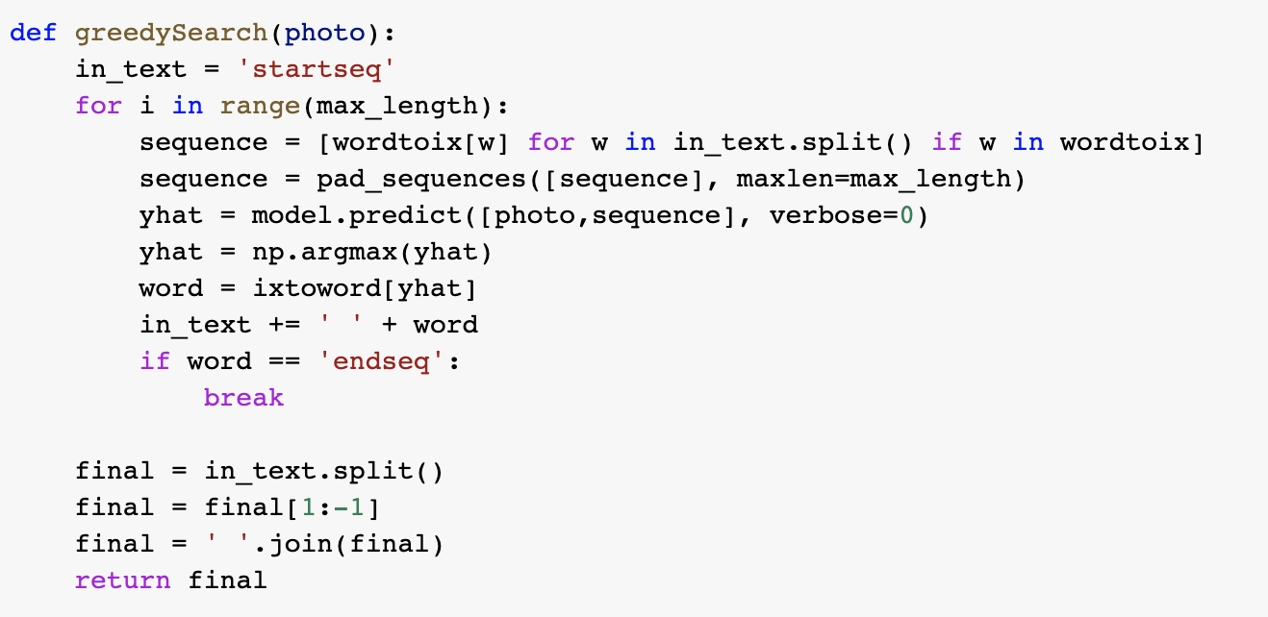
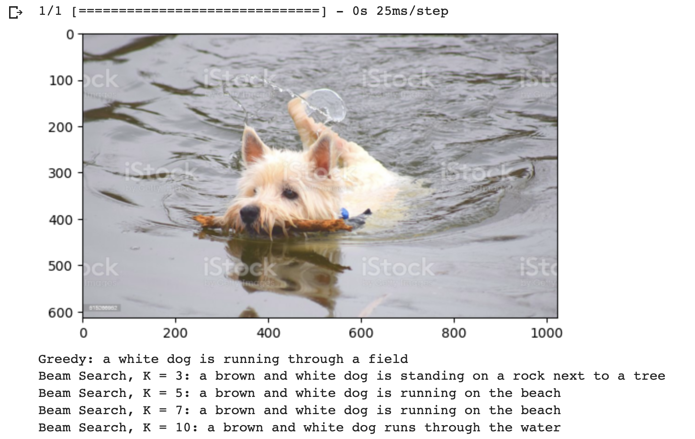
Optimization for Greedy Search
Use beam_search

Slide 7
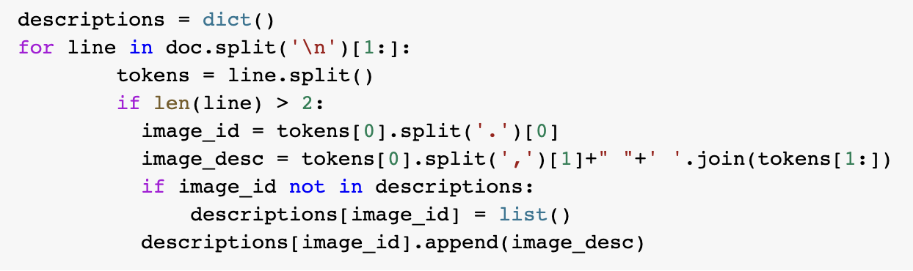
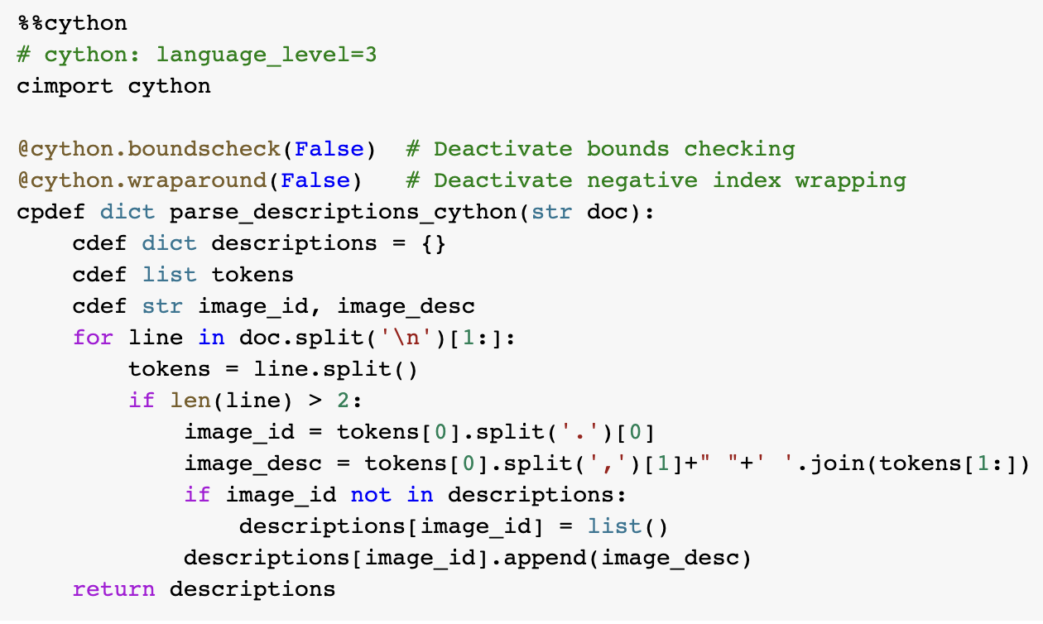
Optimization using Cython
Other data preprocessing (Cython)
0.9s —> 0.3s
Cython

Slide 8
Thanks!

Slide 9
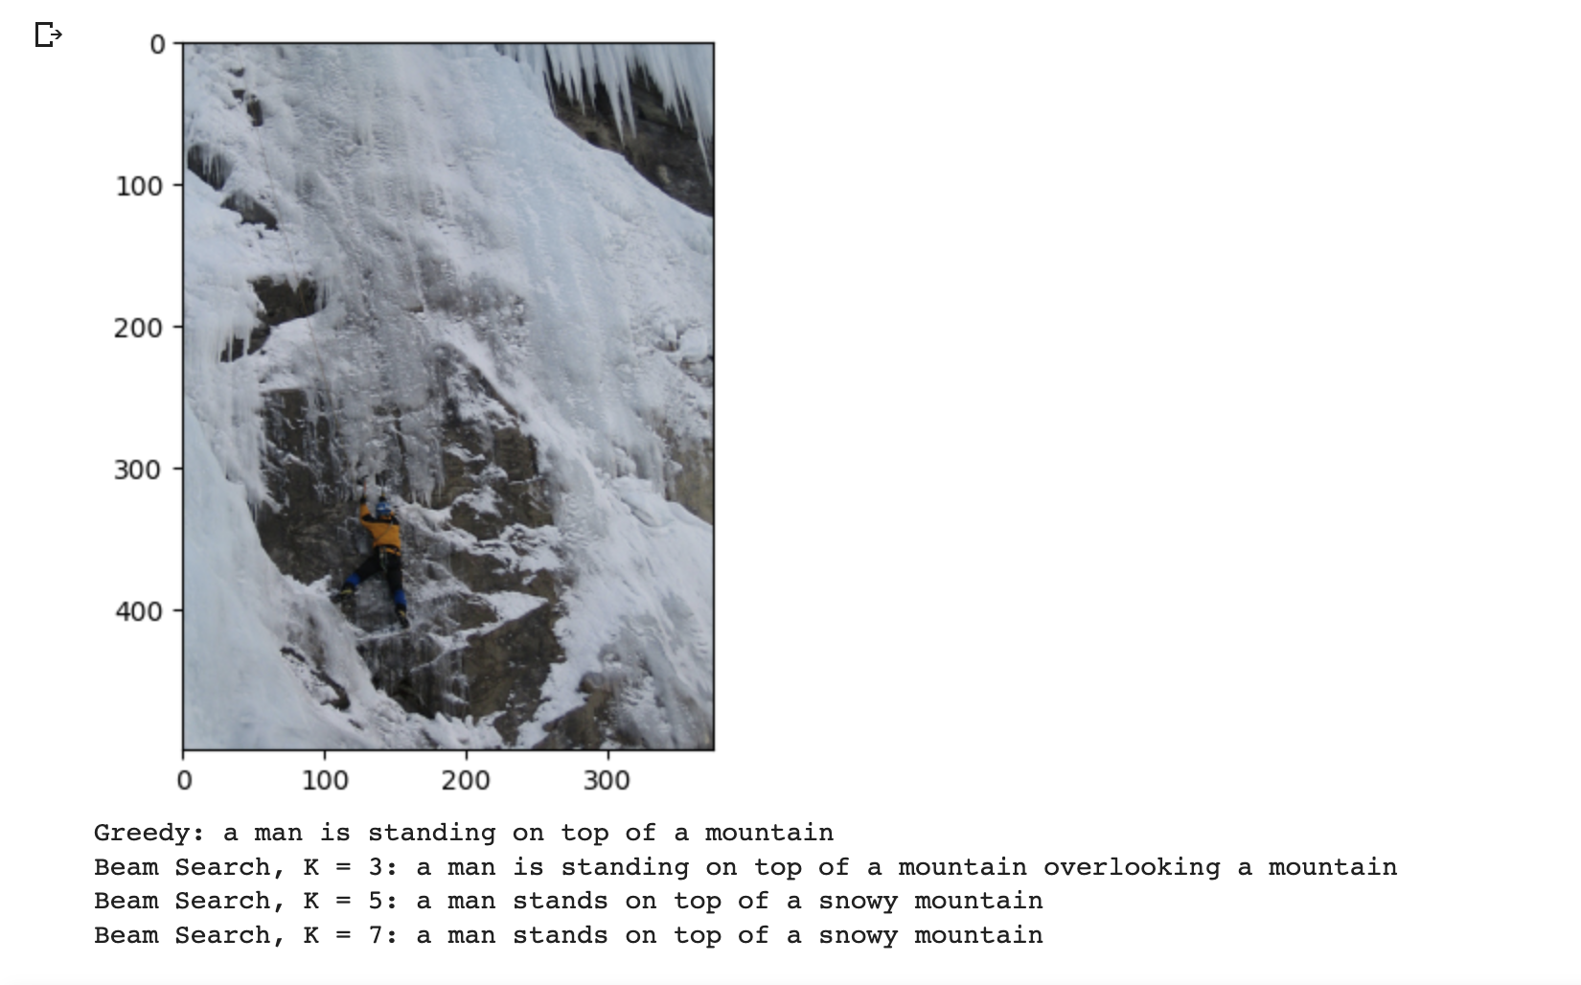
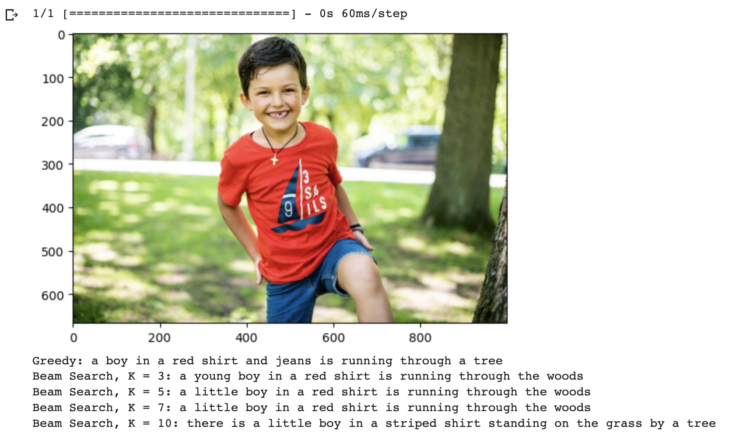
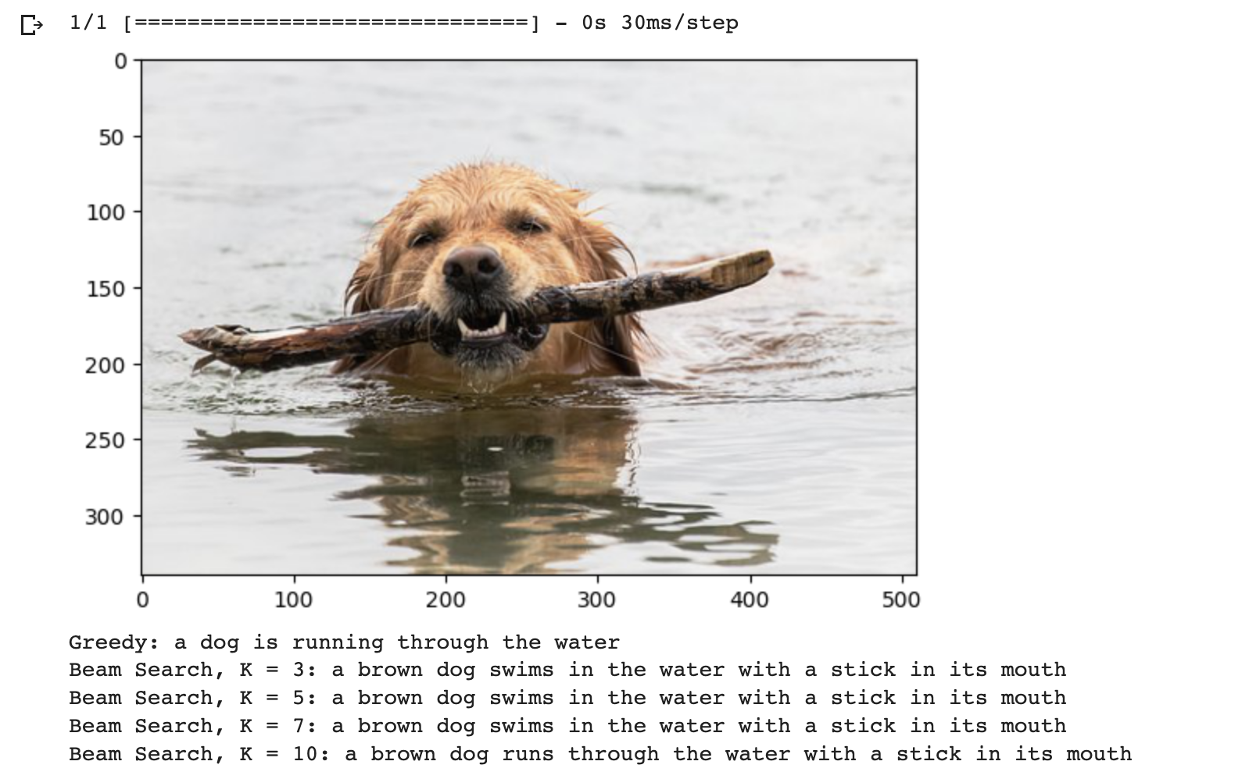
Results

Slide 10
Reference
Ysthehurricane. “Image Caption Generator Tutorial.” Kaggle, Kaggle, 6 Sept. 2021, https://www.kaggle.com/code/ysthehurricane/image-caption-generator-tutorial.
Gautam, Tanishq. “Implementation of Attention Mechanism for Caption Generation on Transformers Using Tensorflow.” Analytics Vidhya, 20 Jan. 2021, https://www.analyticsvidhya.com/blog/2021/01/implementation-of-attention-mechanism-for-caption-generation-on-transformers-using-tensorflow/.
Ranjan, Atul. “Image Captioning with an End-to-End Transformer Network.” Medium, Python in Plain English, 13 June 2022, https://python.plainenglish.io/image-captioning-with-an-end-to-end-transformer-network-8f39e1438cd4.
Gautam, Tanishq. “Create Your Own Image Caption Generator Using Keras!” Analytics Vidhya, 4 Nov. 2020, https://www.analyticsvidhya.com/blog/2020/11/create-your-own-image-caption-generator-using-keras/.

